Slide 1
University American College Skopje
Course: Computer Applications 1
Creation of Excel Charts and PivotTable
Marija Stanojeska, PhD

Slide 2

Based on the textbook:
Microsoft Office Inside Out (Office 2021 and Microsoft 365), J. Habraken, Pearson Education, Inc., 2022.

Slide 3
Understanding Excel charts
Charts are objects (just like a photo or a SmartArt graphic) that can be included anywhere on a worksheet.
Chart area: The area inside the object frame that contains the chart, the axes, the data point labels, the legend, the chart title, and other chart elements.
Plot area: The area of the chart between the chart axes. This is where the data points are plotted.
Data series: Related data points are referred to as a data series.
Categories: Categories reﬂect the number of elements in a series.
Axis: One category, the x-axis often contains labels that deﬁne what each category represents.
Legend: The legend provides the key for how color coding or patterns have been used to diﬀerentiate the diﬀerent elements in a data series on the chart.
Data labels: Labels that appear on the chart denoting the value of the data points used to create the chart.
Gridlines: Gridlines help visualize the value of a particular data point on the chart.
Background: The background consists of the space behind and below the chart area.

Slide 4
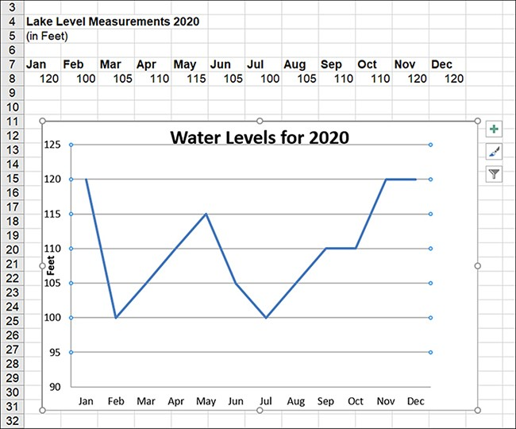
A line chart example

Slide 5
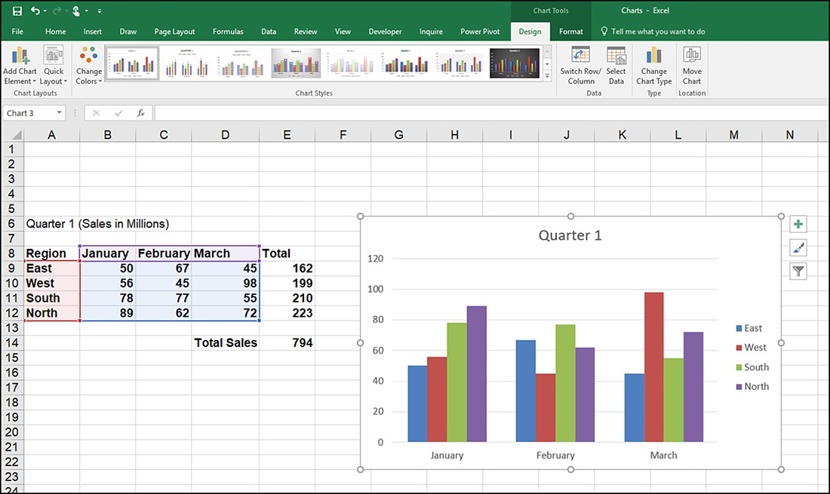
A column chart with multiple data series example

Slide 6
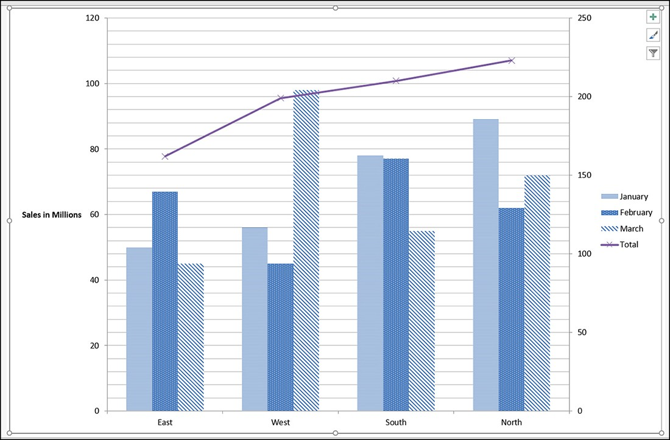
A combination chart graphs data series example

Slide 7
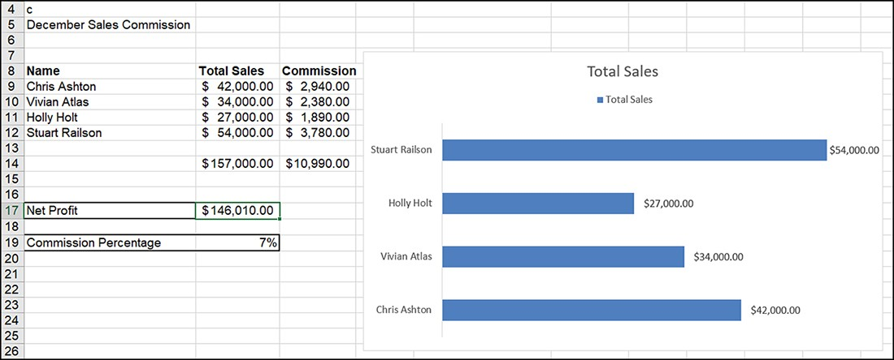
Column chart/bar chart
The column/bar chart is probably one of the most commonly used business chart types. These types of charts work very well in showing how diﬀerent data series or groups of data points compare. Figure shows a bar chart that displays the total sales for each salesperson listed in the worksheet.

Slide 8
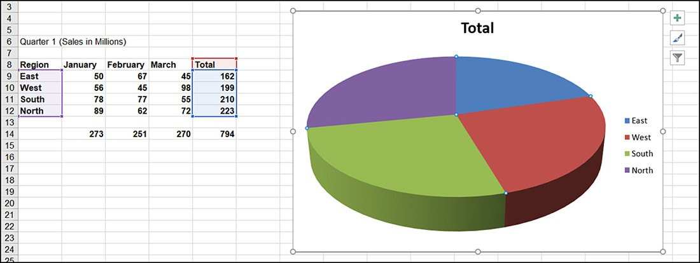
Pie chart
Pie charts enable you to show how the various parts relate to the whole. For example, you might be trying to keep track of your monthly expenses. A pie chart would enable you to visually represent the relative size of each of your monthly expenses as compared with your total expenses.
Pie charts are great for showing how costs, sales, or other data series for a group of categories relate to each other.

Slide 9
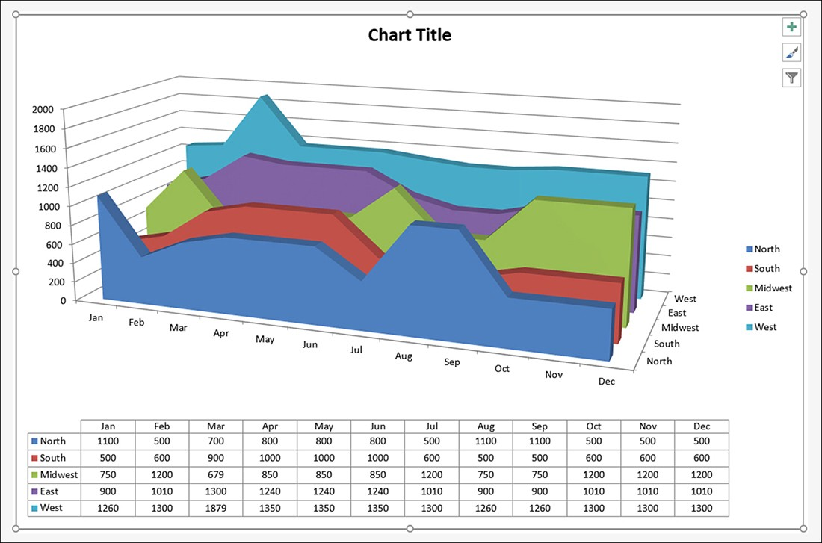
Area chart
Area charts enable you to show trends using cumulative totals over time. These types of charts emphasize the general direction of the data series up or down and show the magnitude of change. Area charts are somewhat similar to line charts; however, area charts show not only trends over time, but can also show how data series shown in the chart relate to the whole and each other. This enables you to view trends related to each data series and to compare data series.

Slide 10
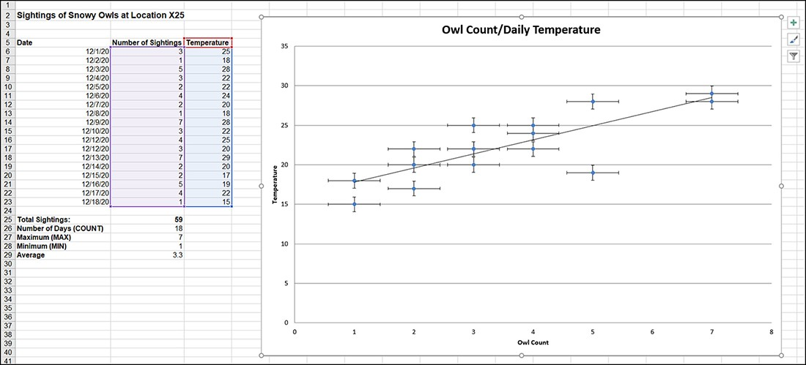
X Y (scatter) chart
Scatter charts enable you to determine whether the data points in a series fall on the chart in a pattern called a cluster. Scatter charts are used to see whether there is a correlation between values. One set of values is plotted on the x-axis and the other set of values is plotted along the y-axis.

Slide 11
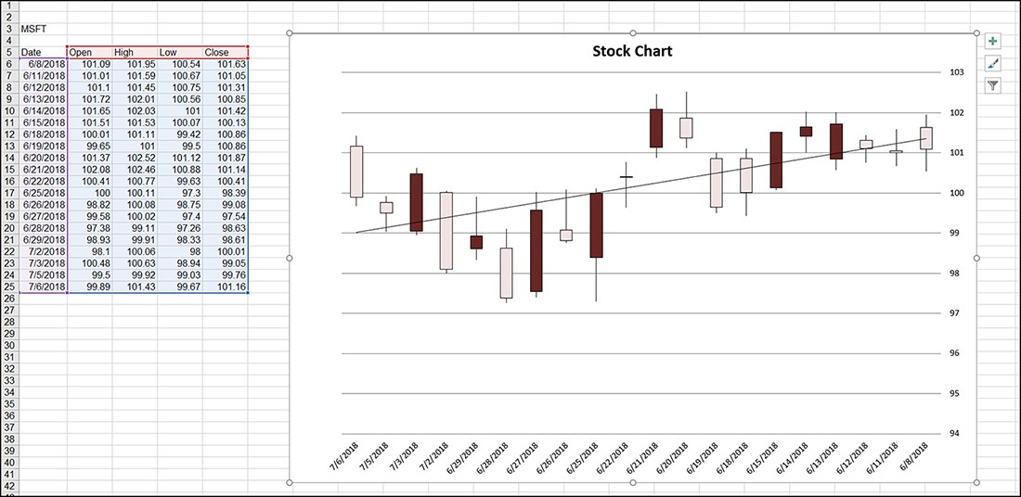
Stock chart
Stock charts (also known as box plots, box and whiskers plots, and candlestick plots) are particularly useful when you are tracking a particular stock that is in your stock portfolio or that you are considering making part of your portfolio. Stock charts can be created using three diﬀerent data series, four diﬀerent data series, or ﬁve diﬀerent data series - all of which are related to the price of the stock.

Slide 12

Training
Exercise 1
Insert a chart.

Slide 13
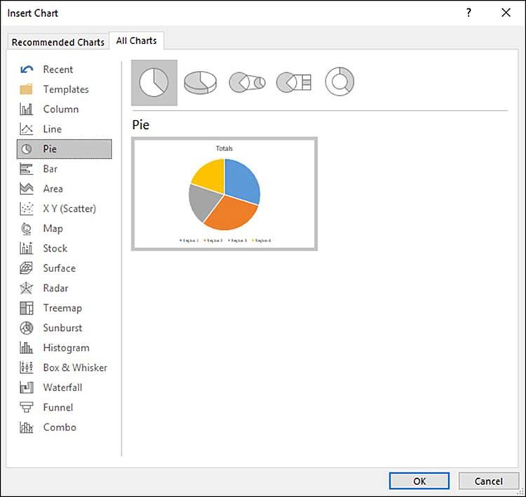
Inserting a chart from the ribbon
To choose the chart type, switch to the ribbon’s Insert tab. The Charts group provides commands for speciﬁc chart types, including Insert Column Chart, Insert Line Chart, and Insert Pie or Doughnut Chart. Select the drop-down arrow to the right of any of these chart commands to select a chart subtype.

Slide 14
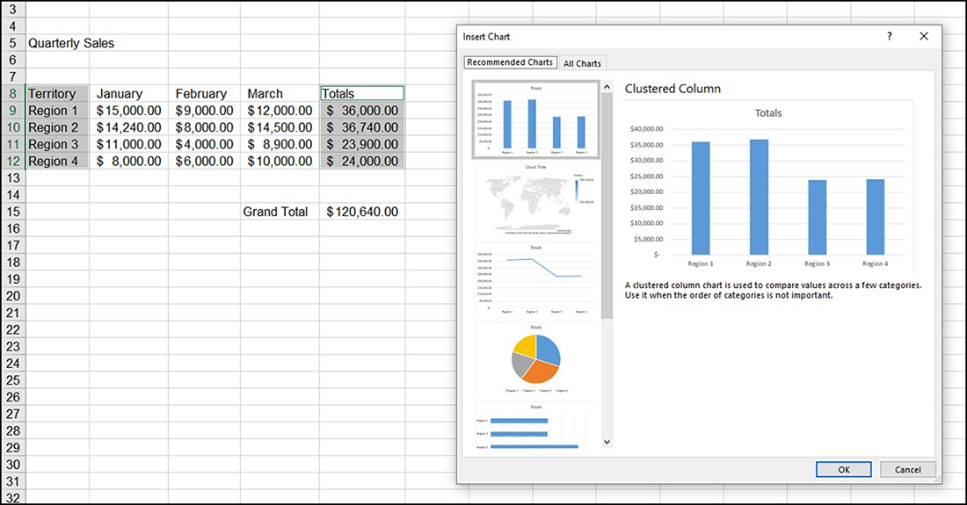
Selecting a recommended chart
The Recommended Charts feature helps you determine the best chart type for your data, and it can be particularly useful in situations where you aren’t quite sure what type of chart would best represent the data in the sheet.
To view recommended charts for your data, select the cell range for the chart and then navigate to the Insert tab. Select the Recommended Charts command in the Charts group. The Insert Chart dialog box opens with the Recommended Charts tab selected.

Slide 15
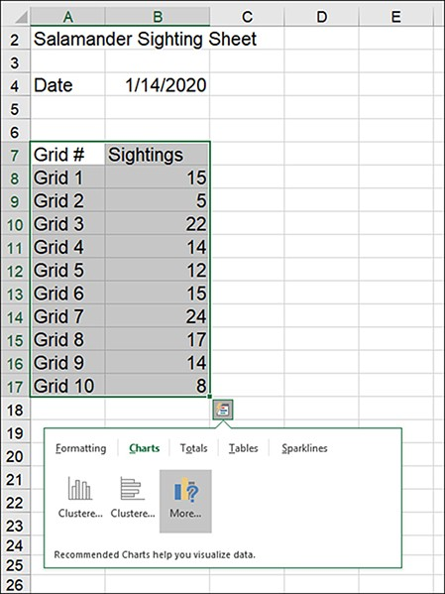
Inserting charts with the Quick Analysis gallery
To insert a chart using the Quick Analysis gallery, select the cell range for the chart. The Quick Analysis button appears at the very bottom right of the selected range. Click the button, and the gallery opens; select Charts to view the Quick Analysis charting options.

Slide 16
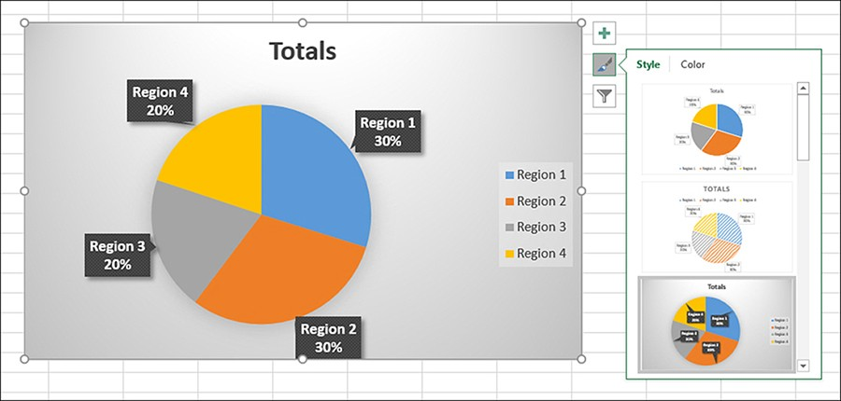
Tools for quickly customizing a chart
The chart is selected when you insert a new chart into the current sheet. Three very useful tools that allow you to quickly customize the chart are available next to the chart’s right border:
  Chart Elements
  Chart Styles
  Chart Filters

Slide 17
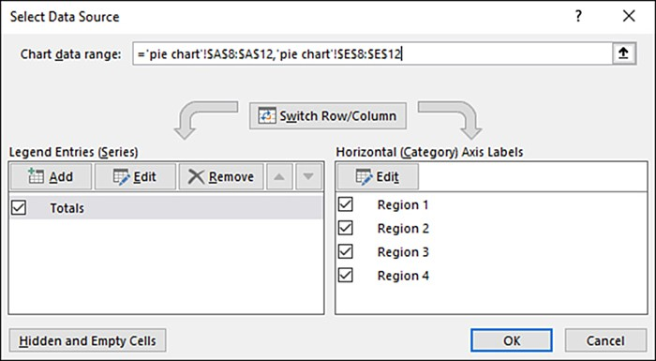
Changing chart type or chart data
To change the chart type, select the Change Chart Type command in the Type group. The Change Chart Type dialog box opens. This dialog box is the same as the Insert Chart dialog box. Select a chart type and/or subtype as needed to change the chart type of the currently selected chart. To apply the change in type or subtype, click OK.
Another command that can be useful in cases where a chart doesn’t look quite right is the Switch Row/Column command. This command can be used in cases where the chart has based the x-axis or y-axis on column data rather than row data and you want to swap the data on the x-axis with the y-axis, or vice versa.

Slide 18
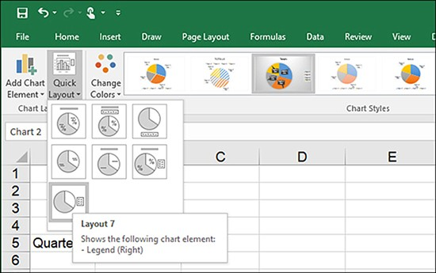
Selecting chart layouts and styles
The various layouts for the currently selected chart can be accessed for a speciﬁc chart type by using the Quick Layout button, which is located on the Design tab’s Chart Layouts group.

Slide 19
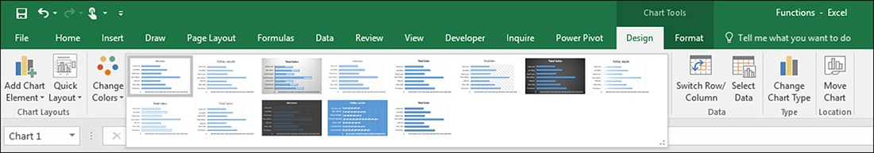
Selecting chart layouts and styles (cont.)
You can also modify the chart using one of the chart styles provided in the Chart Styles gallery. Figure shows the Chart Styles gallery and the chart styles available for a bar chart. These styles aﬀect the data series and the background of the chart (such as the back wall, ﬂoor, and so on). Color schemes for a particular style can be controlled using the Change Colors command (also in the Chart Styles group).

Slide 20
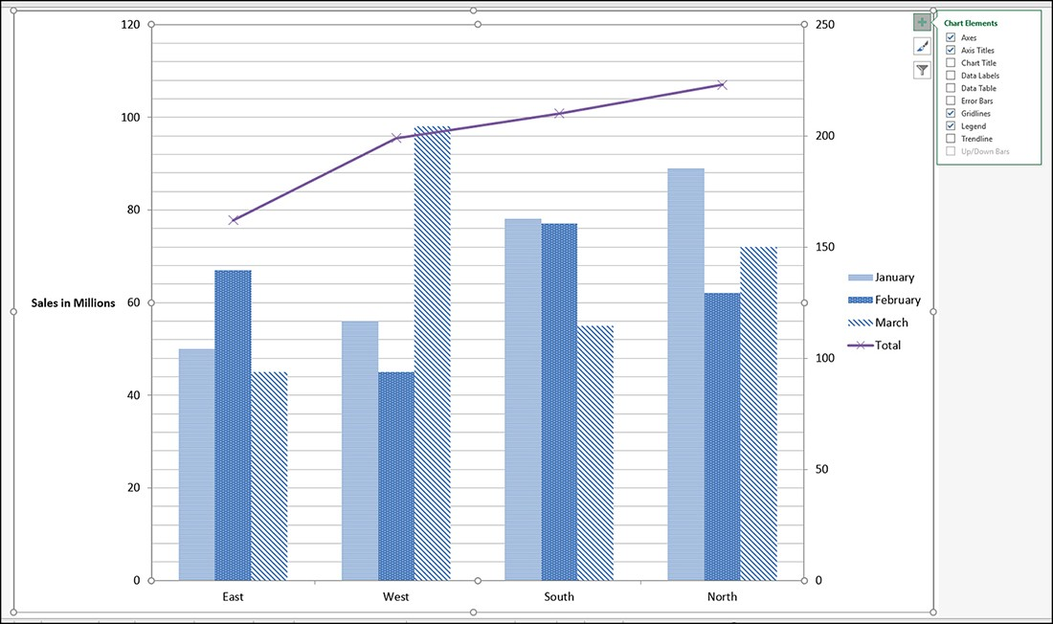
Working with chart elements
You can select a chart element (including the chart area) using the Current Selection group’s drop-down menu. The Current Selection group is on the far left of the Chart Tools, Format tab. The Current Selection group also provides the Format Selection command. This command opens the Format task pane for the currently selected chart element. Individual chart elements are manipulated using the Add Chart Element command on the Chart Tools, Design tab.

Slide 21
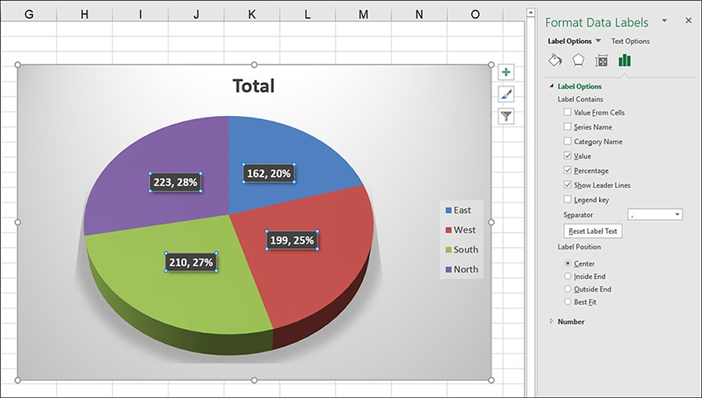
Working with chart elements (cont.)
If you need more control over a particular chart element, you can open the element’s formatting pane. You can open a format task pane for a particular chart element using the Add Chart Element command; select Add Chart Element, then point at the chart element you want to format. On the submenu for the chart element, select the More (name of element) Options command. You can also double-click a chart element in the chart frame to open the associated format task pane.

Slide 22
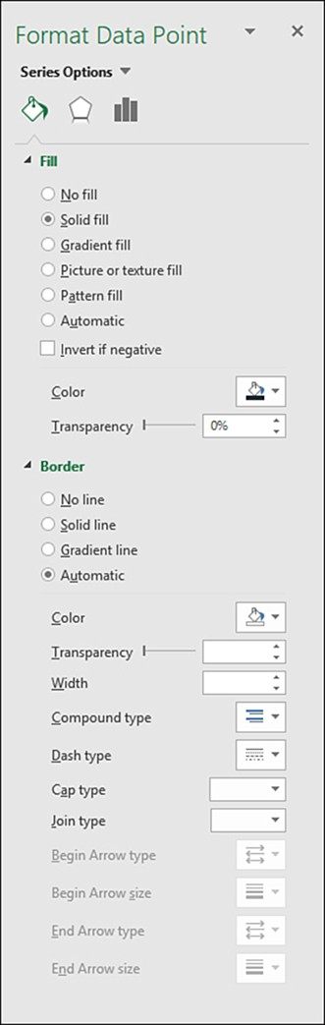
Working with the legend and data points
A shortcut formatting toolbar appears along with a chart-oriented shortcut menu that you can use to access commands such as Select Data, Add Data Labels, and Format Data Series.
The formatting toolbar allows you to access both the Fill and Outline for the currently selected chart element. Select a new ﬁll color using the Fill Color palette. You can also use this shortcut toolbar to change the outline color for the data series.

Slide 23
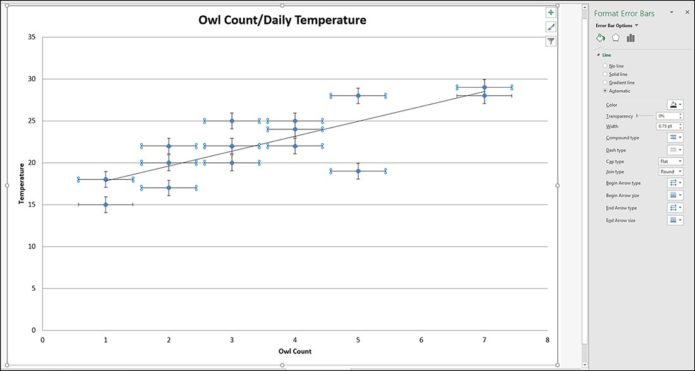
Adding error bars and up/down bars to a chart
The error bars are created on the chart based on an error amount. You can quickly create error bars that use the standard error, percentage, or standard deviation as the error amount. Select Add Chart Element, point at Error Bars, and then select one of the error bar types. Figure shows standard error bars on a scatter chart. The ﬁgure also shows the Format Error Bars task pane.

Slide 24
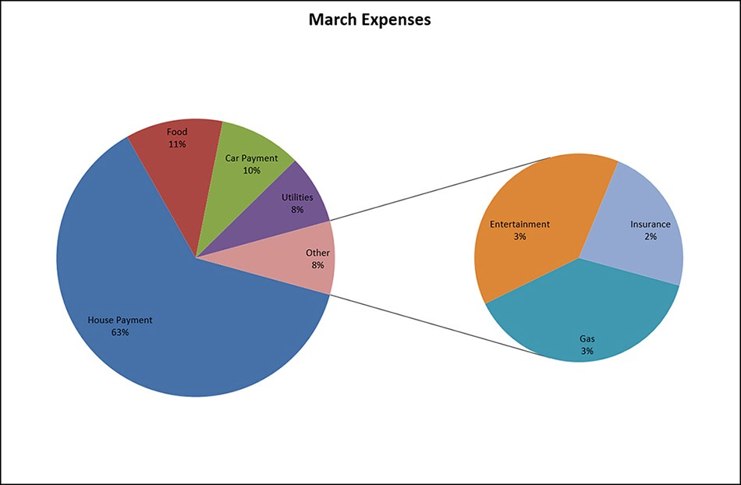
Creating a combination chart
Before we end our discussion of Excel charts, we should look at how you create a combination chart. A combination chart combines two or more chart types in a single chart. Excel provides premade combination charts such as pie of pie and bar of pie charts.

Slide 25
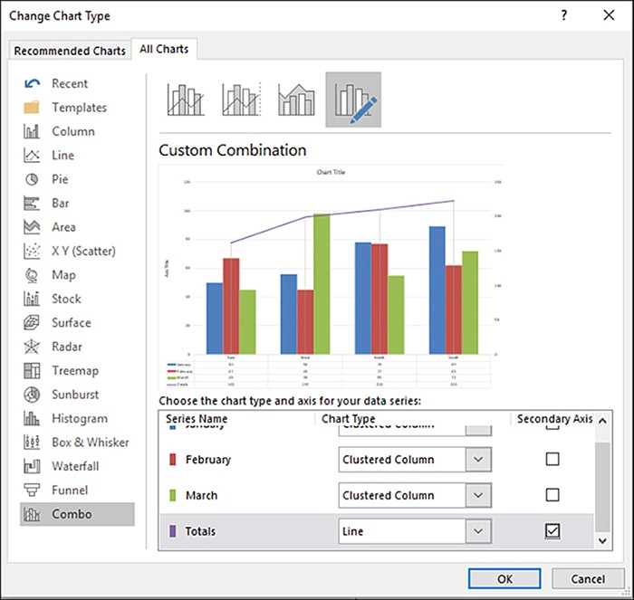
Creating a combination chart
To create a combination chart, select all the data you want to include in the chart, including the data series that serves as the secondary plot.
Select the Insert tab, and then use the chart type commands to insert the chart that serves as the primary plot or chart. Now you need to select the series that you want to convert to a secondary chart. Use the drop-down menu in the Current Selection group (on the Chart Tools, Format tab) to select the data series that provides the values for the secondary plot.
To change the data series to another chart type, you can select the data series and then select Change Chart Type, or you can right-click the selected data series and select Change Series Chart Type from the shortcut menu.

Slide 26
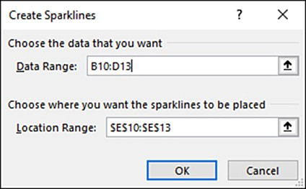
Creating sparklines
Insert tab > Sparklines group
To insert a sparkline, follow these steps:
Select the cell or cell range where you want to insert the sparkline.
Select the sparkline type that you want to insert from the Sparklines group.

Slide 27
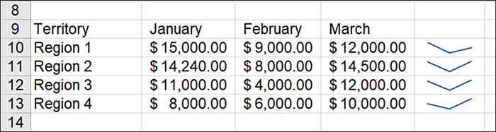
Creating sparklines (cont.)
The Create Sparklines dialog box requires that you specify a data range and a location range. To specify the data range, click the Shrink button and then select the cells that contain the values that are used to create the sparklines.
If you selected the cell range where the sparklines were to be inserted, a location range is already shown in the Location Range text box. If you need to specify the range or edit the current range, click the Shrink button and select the location range. This range will automatically be speciﬁed as an absolute reference.
After the data range and the location range have been selected for the sparklines, click OK. The sparklines appear in the location range cells.

Slide 28
Training
Exercise 2
Create a PivotTable.

Slide 29
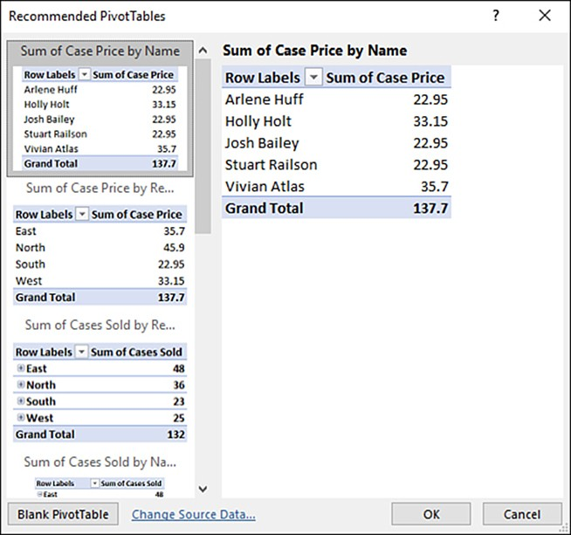
Using the Recommended PivotTables command
The Recommended PivotTables command is in the Insert tab’s Tables group.
Although you can specify the data source for a recommended pivot table, the Recommended PivotTables command works best (and fastest) when you are on a sheet that contains a table and you have already selected the table range that you want to use as the data source for the pivot table.
Then all you have to do is select Recommended PivotTables.

Slide 30
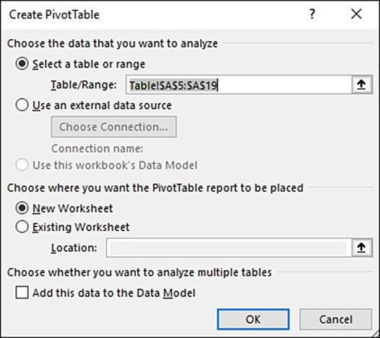
Creating a pivot table
You can also create a new pivot table using the Create PivotTable dialog box, which is opened using the PivotTable command on the ribbon’s Insert tab. To insert a pivot table, follow these steps:
On the ribbon’s Insert tab, select pivot table. The Create PivotTable dialog box opens

Slide 31
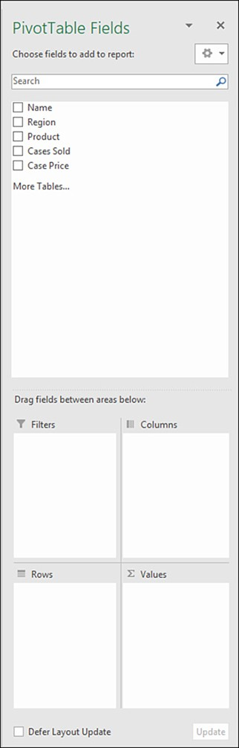
Creating a pivot table (cont.)
To create the pivot table from a table or range on the current worksheet or in the current workbook, click the Table/Range box and then select the range. If you are going to use an external data source, click the Use an External Data Source option button and then click the Choose Connection button. In the Existing Connections dialog box, select a data source and then click Open.
After you have speciﬁed the range for the pivot table or speciﬁed a connection, select either the New Worksheet or Existing Worksheet option button to specify where the pivot table is created. In the case of the Existing Worksheet option, also specify a location for the pivot table. All you need to do is select the cell that serves as the upper-left corner for the pivot table.
Click OK, and the new pivot table’s blank frame is inserted into the current worksheet or a new worksheet. The PivotTable Fields task pane also opens on the right of the Excel window.

Slide 32
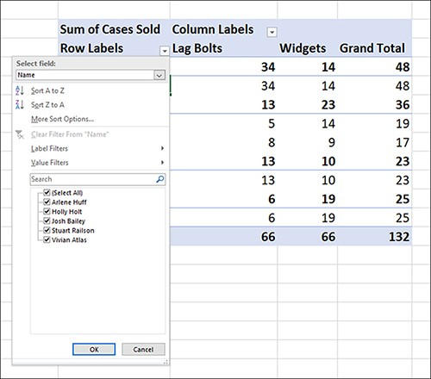
Creating a pivot table (cont.)
The PivotTable Fields task pane is used to specify the data source table ﬁelds that are used in the pivot table. Select the ﬁelds you want to add to the pivot table report. You can drag the ﬁeld names to the diﬀerent report areas, or you can click in an area and then select the check box next to a ﬁeld. As you specify the ﬁelds for the pivot table, the pivot table begins to appear on the sheet.

Slide 33
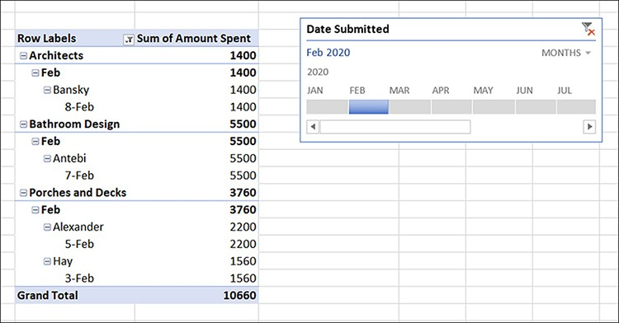
The Analyze tab
Home ribbon > PivotChart Tools > Analyze > Insert Slicer/ Insert Timeline
The Analyze tab enables you to manipulate the ﬁelds in the table and also ﬁlter the data in the pivot table; for example, you can insert a slicer for the pivot table.
You can use the Expand Entire
Field or Collapse Entire Field command in the Active Field group to expand or collapse the currently selected ﬁeld or ﬁelds as needed.
The Filter group contains the Insert Slicer and Insert Timeline command.
The Insert Timeline command is interesting in that it allows you to ﬁlter the data in a pivot table so that only the data that falls within the date range you have speciﬁed on the Timeline slicers shows in the pivot table.

Slide 34
The Design tab
Home ribbon > PivotChart Tools > Design > Subtotals/Grand Totals/ Report Layout/ Blanc rows
The PivotTable Tools, Design tab enables you to manipulate the layout of your calculated ﬁelds and to also assign styles to the pivot table.
The Subtotals command enables you to hide the subtotals or to specify that the subtotals appear at the bottom (the default) or top of a group in the pivot table.
The Grand Totals command enables you to turn the grand totals oﬀ or on for rows and columns or specify that grand totals are shown only for the rows or columns in the pivot table.
The Report Layout command enables you to choose from a number of diﬀerent formats for the pivot table, such as Compact, Outline, and Tabular.
The Blank Rows command is used to insert or remove blank lines after each item in the pivot table.
The PivotTable Styles gallery provides a number of diﬀerent styles that can be applied to the pivot table. If you apply a particular style, you can then use the PivotTable Style Options check boxes to hide or show elements such as row headers, column headers, or banded rows and columns.

Slide 35
Using slicers
A slicer is an easily accessible workspace object that resides on the sheet with the pivot table.
To create a new slicer, select the Insert Slicer command on the PivotTable Tools, Analyze tab.
The Insert Slicers dialog box opens and shows all the ﬁelds available to your pivot table.
A slicer can ﬁlter the data in the pivot table by only a single ﬁeld.
However, you can create multiple slicers by selecting more than one ﬁeld in the Insert Slicers dialog box.
After selecting a ﬁeld (for a single slicer) or multiple ﬁelds (for multiple slicers), click OK.
The new slicer (or slicers) appears on the current worksheet.
The slicer lists the ﬁeld values in the ﬁeld that you selected in the Insert Slicers dialog box.
Select a particular ﬁeld value to ﬁlter the pivot table by that value. To remove the ﬁlter, click the remove ﬁlter icon in the upper-right corner of the slicer’s frame.
When you have a slicer selected, the Slicer Tools, Options tab becomes available on the ribbon.
You can use the styles available and the size settings to format the slicer. If you have multiple pivot tables on a worksheet, you can associate the slicer with those pivot tables.
This enables you to ﬁlter more than one pivot table using a single slicer.
Select the PivotTable Connections command, and the PivotTable Connections dialog box opens. Select the pivot tables listed in the dialog box that you want to associate with the slicer. Then click OK.

Slide 36
Useful links
https://support.office.com/en-us/article/video-sort-data-in-a-range-or-table-ffb9fcb0-b9cb-48bf-a15c-8bec9fd3a472
https://support.office.com/en-us/article/video-use-conditional-formatting-03ab07da-1564-4913-b69f-2b1a370c8910
https://support.office.com/en-us/article/video-vlookup-when-and-how-to-use-it-9a86157a-5542-4148-a536-724823014785
https://support.microsoft.com/en-au/office/video-create-a-pivottable-and-analyze-your-data-7810597d-0837-41f7-9699-5911aa282760
https://support.microsoft.com/en-au/office/video-create-a-pivottable-manually-9b49f876-8abb-4e9a-bb2e-ac4e781df657
https://support.microsoft.com/en-au/office/video-use-slicers-timelines-and-pivotcharts-to-analyze-your-pivottable-data-4db5de3b-735e-4b03-b3b2-f2105d79dcb5
MS Excel Tutorial

Slide 37
Thank you for your attention!

